Slide 1
Restriction Digest Gel of Rx vLRR Candidate 52-76, 187-191, and SRE Effectros 14(A), 16, 17
Meng Zhu
Notes:
Restriction-digest verification of Rx–vLRR constructs. Agarose gel electrophoresis of Rx–vLRR plasmids digested with BamHI and NdeI for candidates 52–76 and 187–191. Experimental banding patterns are shown together with the corresponding predicted virtual digests for comparison. Green ticks indicate samples with banding patterns consistent with the expected restriction profile, while crosses or question marks indicate unsuccessful or inconclusive verification in the corresponding run. Selected candidates were subsequently re-tested where required.

Slide 2
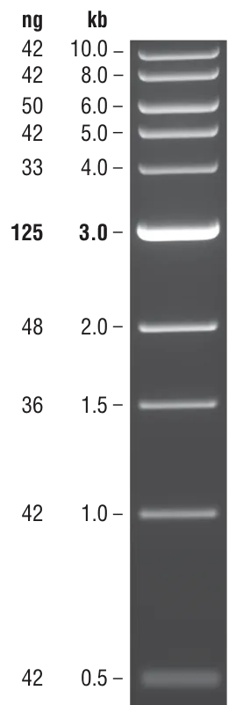

Restriction Digest of Rx Backbone by BamHI and NdeI; 12.06.2026
52
53
54
55
56
57
58
59
60
61
62
63

Slide 3
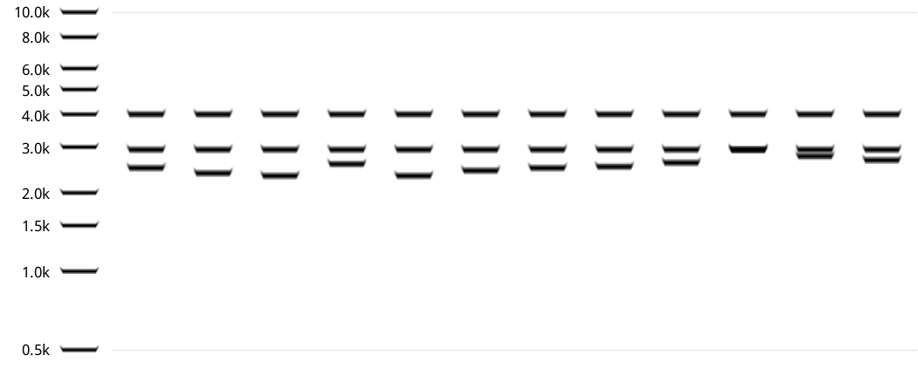
Virtual Gel of Rx vLRR 52-63 Digested By BamHI and NdeI
52
53
54
55
56
57
58
59
60
61
62
63

Slide 4

Restriction Digest of Rx Backbone by BamHI and NdeI; 11.06.2026
61
64
65
66
67
68
69
70
71
72
73
74
75
76
187

Slide 5
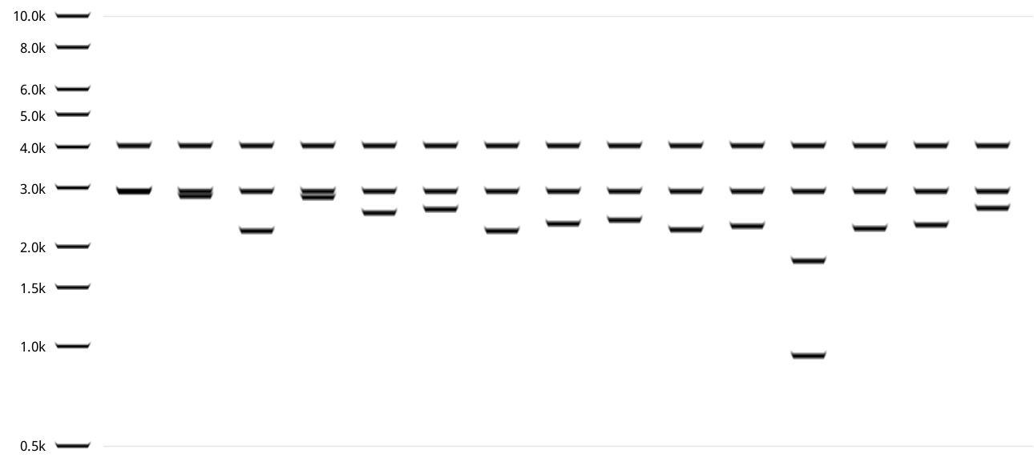
Virtual Gel of Rx vLRR 61, 64-76, 187 Digested By BamHI and NdeI
61
64
65
66
67
68
69
70
71
72
73
74
75
76
187

Slide 6

Restriction Digest of Rx Backbone by BamHI and NdeI
74
75
76
187
188
189
190
191
74
188
12.06.2026
15.06.2026

Slide 7
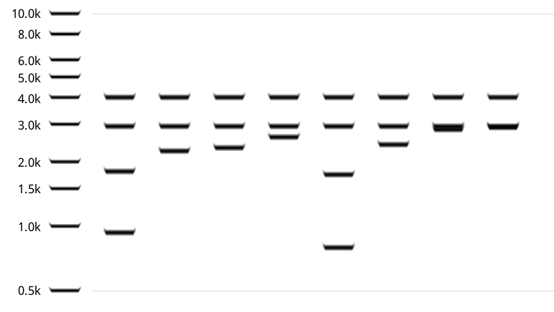
Virtual Gel of Rx vLRR 74-76, 187-191 Digested By BamHI and NdeI
74
75
76
187
188
189
190
191

